Slide 1
Rendezési algoritmusok
A beszúró- és a továbbfejlesztett beszúró rendezés
Készítette: Szabó Tamás, Nagy Kristóf Róbert, Gyarmati Csanád

Slide 2

A BESZÚRÓ RENDEZÉS
A következő adatokat az ábra/oldalon lévő példa alapján kaptuk meg.
ÖSSZEHASONLÍTÁSOK SZÁMA | 12
TÁRIGÉNY | HIÁNYOS ADAT
MOZGATÁSOK SZÁMA | 6
Források:
https://anim.ide.sk/rendezesi_algoritmusok_1.php
Egyéb segítség/forrás:

Slide 3
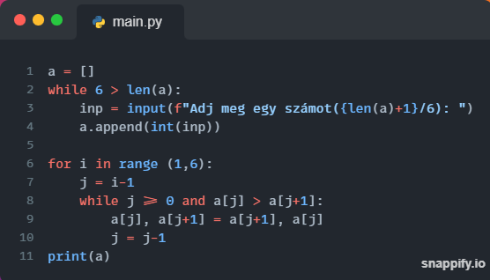
Python Megoldás (Szabó Tamás)
Beszúró rendezés:

Slide 4
A BESZÚRÓ RENDEZÉS
A következő adatokat az ábra/oldalon lévő példa alapján kaptuk meg.
ÖSSZEHASONLÍTÁSOK SZÁMA | 12
TÁRIGÉNY | HIÁNYOS ADAT
MOZGATÁSOK SZÁMA | 6
COLORS | All the colors used in this presentation
INFOGRAPHIC RESOURCES | These can be used in the template, and their size and color can be edited
CUSTOMIZABLE ICONS | They are sorted by theme so you can use them in all kinds of presentations
Források:
https://anim.ide.sk/rendezesi_algoritmusok_1.php
Egyéb segítség/forrás:

Slide 5

INTRODUCTION
You can give a brief description of the topic you want to talk about here. For example, if you want to talk about Mercury, you can say that it’s the smallest planet in the entire Solar System

Slide 6

SOME TYPES OF MODELING
DESCRIPTIVE
ANALYTICAL
Saturn has several rings. It's composed of hydrogen and helium
Neptune is the fourth-largest planet by diameter in the Solar System

Slide 7

TYPES OF CODING
COMPRESSION
ERROR CONTROL
CRYPTOGRAPHIC
LINE
Venus has a beautiful name and is the second planet from the Sun
Earth is the only planet that harbors life in the Solar System
Despite being red, Mars is actually a cold place. It's full of iron oxide dust
Jupiter is a gas giant and the biggest planet in the Solar System

Slide 8
—SOMEONE FAMOUS
“This is a quote, words full of wisdom that someone important said and can make the reader get inspired.”

Slide 9
ICON PACK

Slide 10
Use our editable graphic resources...
You can easily resize these resources without losing quality. To change the color, just ungroup the resource and click on the object you want to change. Then, click on the paint bucket and select the color you want. Group the resource again when you’re done. You can also look for more infographics on Slidesgo.

Slide 12
...and our sets of editable icons
You can resize these icons without losing quality.
You can change the stroke and fill color; just select the icon and click on the paint bucket/pen.
In Google Slides, you can also use Flaticon’s extension, allowing you to customize and add even more icons.

Slide 13
Educational Icons
Medical Icons

Slide 14
Business Icons
Teamwork Icons

Slide 15
Help & Support Icons
Avatar Icons

Slide 16
Creative Process Icons
Performing Arts Icons

Slide 17
Nature Icons

Slide 18
SEO & Marketing Icons

